Slide 1

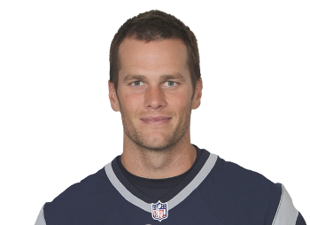
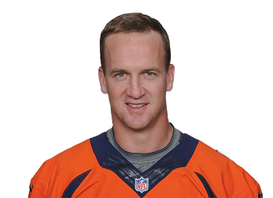

NFL Draft: Science or Guessing
The Problem: Are NFL teams just making educated guesses when it comes to draft picks?
Data: NFL draft outcomes dataset on Kaggle.
Hypotheses: Although not perfect, NFL draft system is effective at identifying league-level talent.

Slide 2



Video Game Reviews and Sales
The Problem: Determine if video game ratings impact sales.
Data: Video Game Sales with Ratings dataset on Kaggle.
Hypotheses: There is a correlation between video game ratings and global sales.

Slide 3



Predicting Terror Attacks in Egypt
The Problem: Are the terror attacks in Egypt essentially random or is there a decipherable pattern? Important to governments, security entities, and tourists.
Data: Global Terrorism Database Dataset on Kaggle.
Hypotheses: Terror attacks in Egypt over the past five years are not following a random pattern. Success would be a model able to predict future attacks with 85% accuracy.

